Slide 1
Data Engineering with GCP
Data Analysis using BigQuery

Slide 2
Revision History
Version | Date | Author | Reviewed by | Comments
2.0 | -Sep-2021 | Snigdha Rane Bhawsar |  | Initial Version

Slide 3
Understand the fundamentals of data warehousing and its role in modern analytics.
Learn the key features and capabilities of a serverless data warehouse.
Explore architecture, pricing models, and access roles for efficient data governance.
Understand how optimization techniques improve query performance and cost efficiency.
Learn how to create and use structured views for simplified and secure data access.
Develop SQL querying skills to retrieve and analyze large datasets efficiently.
Explore advanced analytics, including window functions, ML integration, and optimization.
Understand cross cloud analytics and best practices for security and performance.
Learn to use interactive notebooks for data exploration and analysis.

Slide 4

Data Warehouse Overview

Slide 5
What is Datawarehouse
Definition
A Data warehouse is a system used for reporting and data analysis.
Also known as a centralized repository containing summarized and comprehensive data for business analysis.
Data will be accumulated from a wide range of sources.
It works on top of transactional databases for analytics purposes.
Multiple Sources
Transformation
Load
Target
Extracted

Slide 6
Types of Enterprise Data Warehouses
Three main types of Data Warehouses
Enterprise Data Warehouse: Centralized data warehouse to provide the complete view to organize and present data
Data Mart: Used and designed for department data, for example – Supply Chain, Marketing, Sales, etc.
Operational Data Source (ODS): It supports the business’s reporting requirement.
Notes:
There are three main types of data warehouse (DWH) mainly used in enterprise systems. These are the enterprise data warehouse, operational or functional data store, and unit-specific data mart or data lake:
Enterprise Data Warehouse (EDW): As a centralized data warehouse, EDW provides a holistic approach to organize and present data.
Operational Data Store (ODS): ODS is a data store for neither the OLTP nor data warehouse can support a business’s reporting requirements.
Data Mart: A data mart is designed for departmental data, such as sales, finance, and supply chain.

Slide 7
Characteristics of Data warehouse
Subject Oriented
Data organized around subject
Focus on Analysis and modeling of data
Simple and concise
Integrated
Multiple data sources
Cleansing of data
Conversion of data in a common format
Time-Variant
Maintained data based on different time intervals
Stores historical data
Non-Volatile
Once the record is added will not get updated
Only two operations
Incremental loading of data
Access to Data
Notes:
https://www.geeksforgeeks.org/characteristics-and-functions-of-data-warehouse/

Slide 8



Datawarehouse Architectures
Data Sources
Staging Area
Warehouse
Users
Operational System
Analytics
Operational System
Summary Data
Reporting
Raw data
Metadata
Files
Mining

Slide 9
ETL
ETL is a process that extracts data from multiple sources, transforms it into a common format, and load the data into the warehouse for analysis.
Data Sources
Transform
Extracted raw data will be transformed in in common format
Data Warehouse
Databases
Staging Area
Extract
Load
ERP/CRM
Events

Slide 10
ETL Processing
Source DB
Extraction & Cleansed data in Staging DB
Transformed Data in Stagging DB
Data Warehouse
Extraction
Cleaning for extracted data from source
Transform
Using Mapping and Transformation rules data will be transformed
Load
Data will gets loaded into the warehouse

Slide 11

Types of Datawarehouse Architecture
Single-tier architecture
Single layer is to minimize the amount of data stored.
Removes data redundancy.
Not frequently used in practice.
Source Layer
Data Warehouse
Layer
Analysis
Layer
Reporting
Operational Data
Middle Ware
Analysis
Notes:
Single-tier architecture
The objective of a single layer is to minimize the amount of data stored. This goal is to remove data redundancy. This architecture is not frequently used in practice.
https://www.javatpoint.com/data-warehouse-architecture
https://www.guru99.com/data-warehouse-architecture.html

Slide 12

Types of Datawarehouse Architecture cont.…
Two-tier architecture
Separates physically available sources and data warehouse.
Not expandable architecture
Not supports large number of end-users
Connectivity issues because of network limitations.
Source Layer
Operational
External
Data Staging
ETL
Data Warehouse
Metadata
Data Warehouse
Layer
Data marts
Data marts
Data marts
Data marts
Analysis
Layer
Mining
Reporting
Analysis
What-If
Analysis
Notes:
Two-tier architecture
Two-layer architecture is one of the Data Warehouse layers which separates physically available sources and data warehouse. This architecture is not expandable and also not supporting a large number of end-users. It also has connectivity problems because of network limitations.
https://www.guru99.com/data-warehouse-architecture.html

Slide 13
Types of Datawarehouse Architecture cont.…
Three-Tier Data Warehouse Architecture
Most widely used Architecture of Data Warehouse as consisted of below Tiers.
Bottom Tier
Middle Tier
Top-Tier
Source Layer
Operational
External
Data Staging
Reconciled Layer
Reconciled Data
ETL Tools
Loading
Data Warehouse
Metadata
Data Warehouse
Layer
Data marts
Data marts
Data marts
Data marts
Analysis
Layer
Mining
Reporting
Analysis
What-If
Analysis
Notes:
Three-Tier Data Warehouse Architecture
This is the most widely used Architecture of Data Warehouse.
It consists of the Top, Middle and Bottom Tier.
Bottom Tier: The database of the Datawarehouse servers as the bottom tier. It is usually a relational database system. Data is cleansed, transformed, and loaded into this layer using back-end tools.
Middle Tier: The middle tier in Data warehouse is an OLAP server which is implemented using either ROLAP or MOLAP model. For a user, this application tier presents an abstracted view of the database. This layer also acts as a mediator between the end-user and the database.
Top-Tier: The top tier is a front-end client layer. Top tier is the tools and API that you connect and get data out from the data warehouse. It could be Query tools, reporting tools, managed query tools, Analysis tools and Data mining tools.
https://www.guru99.com/data-warehouse-architecture.html

Slide 14
Datawarehouse Components
Metadata: Metadata is data about data which defines the data warehouse
Data Marts: A data mart is an access layer which is used to get data out to the users. It is presented as an option for large size data warehouse as it takes less time and money to build
Query Tools. Query tools allow users to interact with the data warehouse system. These tools fall into four different categories:
Query and reporting tools
Application Development tools
Data mining tools
OLAP tools
Notes:
https://www.guru99.com/data-warehouse-architecture.html

Slide 15
Datawarehouse Components cont.
Cleansing and
Transformation
Transactional DB
Reporting
Analysis
Mining Tools
ETL
Interactive
Reports
Operational System
Data Warehouse
Query
Tools
Data Mart
Adhoc
Reports
Data Mart
Static
Reports
Analytics Application
External Data
Metadata
Notes:
https://www.guru99.com/data-warehouse-architecture.html

Slide 16
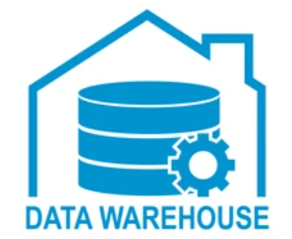
Advantages of Data Warehouse
Delivers enhanced business intelligence
Saves times
Enhances data quality and consistency
Generates a high Return on Investment (ROI)
Provides competitive advantage
Improves the decision-making process
Enables organizations to forecast with confidence
Streamlines the flow of information
Data Warehousing for Historical Data
Increases Data Security
Notes:
https://datawarehouseinfo.com/data-warehouse/benefits-of-a-data-warehouse/

Slide 17
Transactional Databases vs Data Warehouses
Transactional System | Data Warehouse
Database is a collection of related data that represents some elements of the real world | Data warehouse is an information system that stores historical and commutative data from single or multiple sources
Designed to record data | Designed to analyze data
Application-oriented-collection of data | Data Warehouse is the subject-oriented collection of data
Online Transaction Processing systems | Online Analytical Processing systems
Tables and joins are complicated because they are normalized | Tables and joins are easy because they are denormalized
Standardized and simple queries | Complex queries
Backup is taken regularly to ensure business continuity | No regular backup required; lost data can be taken from OLTP database
Example: Cloud Firestore, MySQL | Example : Big Query
Notes:
https://www.guru99.com/database-vs-data-warehouse.html

Slide 18
Introduction to BigQuery

Slide 19
Big Data
For Analytical Processing
Data distributed on a cluster with multiple machines
Semi-structured or unstructured data
No random access to data
Data replicated, propagation of updates take time
Different sources may have different unknown formats

Slide 20




















3 Vs Of Big Data
Support for 3 V
Velocity
Volume: Amount of data
– Scales to petabytes
Variety: Number and type of sources
Support federated data sources
Cloud storage
BigTable
Google Drive spreadsheets
Velocity: Batch and streaming
Streaming ingestion
Real-time queries
Volume
P B
TB GB
MB
Variety

Slide 21
BigQuery vs Traditional Warehouse
BigQuery
Traditional Warehouse
Complex analytical queries
Scales to Petabytes
Both reads and updates
Fast real-time or batch access
Multiple data sources
Streaming as well as batch
Complex analytical queries
Scales to Petabytes
Mostly reads
Long running jobs
Multiple data sources
Often more focus on batch

Slide 22
BigQuery features
Serverless
Highly Scalable
Fully Managed
Built-in Query engine
SQL Interface
Petabyte Scale
Terabytes of Data processed in Seconds
Streaming and real-time analytics
The scale and speed are notable features of BigQuery.
Analytics-As-A-Service

Slide 23
BigQuery features Cont.
Highly- parallelized compressed geographically replicated columnar Structured storage.
Large multi-tenant compute cluster.
Joins and Shared Datasets
Simple data ingest from Hadoop or GCS
Unlimited Storage

Slide 24
BigQuery Architecture, Costing & Roles

Slide 25
BigQuery Architecture
Architecture
Google handles Big Data every second of every day to provide services like Search, YouTube, Gmail and Google Docs
Dremel technology is used by Google’s interactive ad-hoc query system for analysis
BigQuery is built on top of Dremel technology which has been in production internally in Google
since 2006
BigQuery is the public implementation of Dremel that was recently launched to general availability

Slide 26




BigQuery Architecture
Replicated Distributed Storage 99.99999% durability
Big Query
Highly available cluster
Compute (Dreml)
Streaming Insert
Distributed Memory
Shuffle Tier
Batch Insert

Slide 27
Dremel
The cloud-powered massively parallel query service
Dremel Can Scan 35 Billion Rows Without an Index in Tens of Seconds
It can parallelize each query and run it on tens of thousands of servers simultaneously
No index or any pre-aggregated values are prepared in advance
Columnar Storage
Data is stored in a columnar storage fashion which makes possible to achieve very high compression ratio and scan throughput
Tree Architecture
Used for dispatching queries and aggregating results across thousands of machines in a few seconds

Slide 28
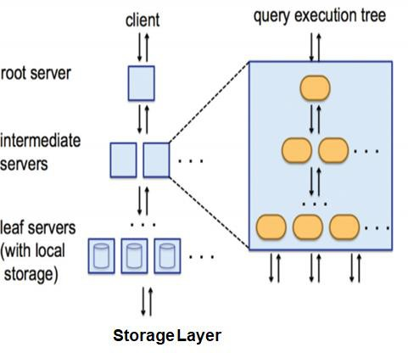
Dremel Architecture
Tree Structure
Root server:
receives incoming queries from clients and routes the queries to the next level
responsible to return query results to the client
Leaf nodes:
Performs heavy lifting of reading the data from Colossus and performing filters and partial aggregation
To parallelize the query, each serving level performs (Root and Mixers) query rewrite and ultimately modified and partitioned queries reach to the leaf nodes for execution

Slide 29
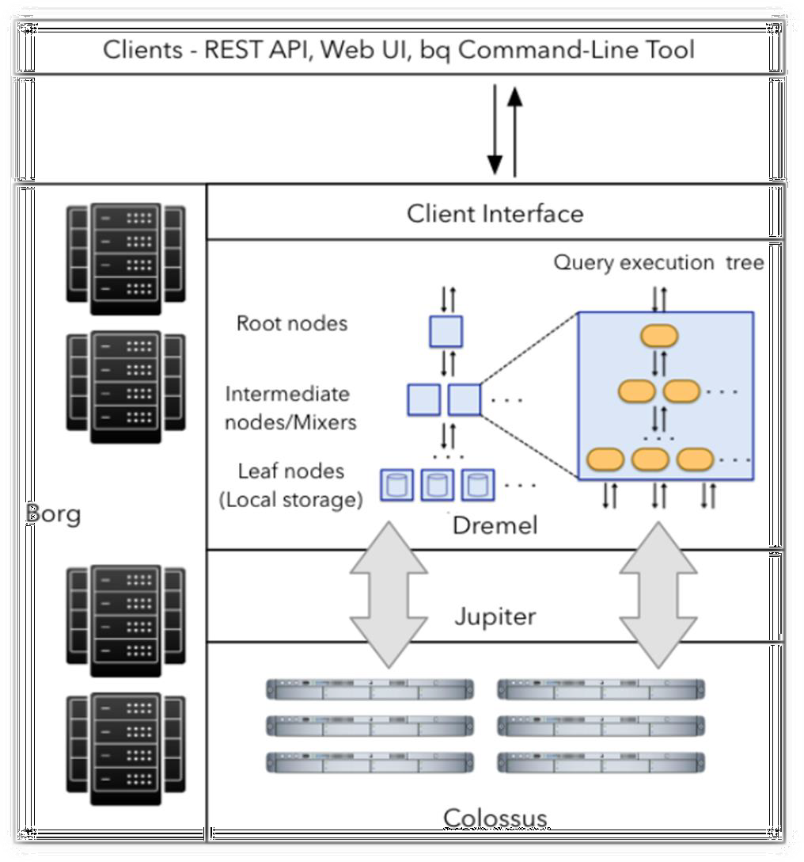
BigQuery Architecture
Build on Dremel
BigQuery client interact with Dremel engine via a client interface
Borg: Google’s large-scale cluster management system - allocates the compute capacity for the Dremel jobs
Dremel jobs read data from Google’s Colossus file systems using Jupiter network, perform various SQL operations and return results to the client

Slide 30
BigQuery Costing
On-demand
Analysis
Queries Functions Scripts DDL DML
Number of bytes processed by each query
Flex
Flat
BigQuery Pricing
Dedicated Slots assigned which are VCPU’s
Monthly
Active
Storage
Yearly
table or partition which is modified in the last 90 days
Based on Loaded Data in BigQuery
Long-term
table or partition modified in
the 90 consecutive days

Slide 31
BigQuery Costing
Operation | Pricing | Details
Active Storage | $0.020 Per GB | The first 10 GB is free each month.
Long Term Storage | $0.010 Per GB | The first 10 GB is free each month.
BigQuery Storage API | $0.10 Per TB | The big Query Storage API is not included in the free tier.
Streaming Insert | $0.010 Per 200 MB | The charge is based on successfully inserted rows. Individual rows are calculated using 1KB min. size.
Queries on Demand | $5.00 Per TB | First 1 TB per month is free.
Flat Rate Monthly | $10000 Per 500 Slots | We can purchase additional slots in 500 Slots increment.
Flat Rate Yearly | $8500 Per 500 Slots | We can purchase additional slots in 500 Slots increment. Billing will be monthly
Big Query Slots: Unit of computational capacity required to execute SQL queries. BigQuery automatically
calculates how many slots are required by each query, depending on query size and complexity

Slide 32
BigQuery Costing
Free Operations
Loading data
– (Streaming inserts not free)
Copying data
Exporting data
Deleting datasets
Deleting tables, views, partitions
Metadata operations

Slide 33
BigQuery Costing
Metadata Operations
Not charged for list, get, patch, update and delete calls for datasets
Not charged for querying the contents of pseudo columns
_TABLE_SUFFIX -> querying wildcard tables
_PARTITIONDATE
_PARTITIONTIME
_FILE_NAME -> querying external data sources
Not charged for querying metadata tables
PARTITIONS_SUMMARY
TABLES_SUMMARY

Slide 34
BigQuery Costing
Minimizing the cost
Query only columns you need
Under the hood, BigQuery is columnar
Each column stored separately in encrypted, replicated file
Use table preview to explore data
Don’t run queries just to explore
Calculate query price before running
dry_run flag in CLI
query validator in UI
GCP pricing calculator

Slide 35
BigQuery Storage
Capacitor & Colossus
BigQuery stores data in a columnar format known as Capacitor
Each column is stored in a separate Capacitor file which enables BigQuery to achieve very high compression ratio and scan throughput
Capacitor directly operate on compressed data, without decompressing the data on the fly
You can import your data into BigQuery storage via Batch loads or Streaming
BigQuery leverages Capacitor to store data in Colossus
Colossus is Google’s latest generation distributed file system and successor to GFS
Colossus handles cluster-wide replication, recovery and distributed management

Slide 36
BigQuery Roles
You can grant access at the following BigQuery resource levels:
organization or Google Cloud project level
dataset level
table or view level
Notes:
https://cloud.google.com/bigquery/docs/access-control
Roles applied at an organization or Google Cloud project level
When you assign roles at the organization and project level, you provide permission to run BigQuery jobs or to access all of a project's BigQuery resources.
Roles applied at a dataset level
You can assign roles at the dataset level to provide access to a specific dataset, without providing complete access to the project's resources. In the IAM policy hierarchy, BigQuery datasets are child resources of projects. For more information on assigning roles at the dataset level, see Controlling access to datasets.
Roles applied to individual resources within datasets
You can assign roles individually to certain types of resources within datasets, without providing complete access to the dataset's resources.
Roles can be applied to individual resources of the following types:
tables
views

Slide 37
BigQuery ROLES
BigQuery Data Owner
BigQuery Data Viewer
BigQuery Job User
BigQuery Metadata Viewer
BigQuery User
BigQuery Resource Admin
BigQuery Resource Editor
BigQuery Resource Viewer
Some of the predefined BigQuery Roles are:

Slide 38
Partitioning, Clustering and Sharding

Slide 39
Partitioned Tables
Divided into segments
A partitioned table is a special kind of table that is divided into segments, called partitions
Make it easier to manage and query your data
Improve query performance
Types of Partitioning
Ingestion time: Tables are partitioned based on the data's ingestion (load) time or arrival time.
Date/timestamp/datetime: Tables are partitioned based on a TIMESTAMP, DATE, or DATETIME column.
Integer range: Tables are partitioned based on an integer column.

Slide 40
When to use Partioning
You want to scan a portion of a table in order to optimize query performance.
When a standard table quota is exceeded by table operation.
Before a query executes, if you want to determine the cost.
We can use Partioning to have the following features
To Set up partition expiration time
To Write data to a specific partition
To Delete specific partitions

Slide 41
Partitioned Tables
Integer range
Allows partitioned tables based on a specific INTEGER column, with your choice of start, end, and interval values
Queries against integer range partitioned tables can specify predicate filters based on the partitioning column to reduce the amount of data scanned
To create an integer range partitioned table, you provide:
the column used to create the integer range partitions
the start of range partitioning (inclusive)
the end of range partitioning (exclusive)
the interval of each range within the partition

Slide 42
Partitioned Tables
Ingestion time
BigQuery automatically loads data into daily, date-based partitions that reflect the data's ingestion or arrival time
Pseudo column and suffix identifiers allow you to restate (replace) and redirect data to partitions for a specific day
Include a pseudo column named _PARTITIONTIME: a date based timestamp

Slide 43
Partitioned Tables
Date, timestamp, or datetime
Allows partitioned tables based on a specific UTC DATE,TIMESTAMP, or DATETIME column
Automatically delivered to the appropriate partition based on the time-unit value
The __NULL__ partition: represents rows with NULL values in the partitioning column
The __UNPARTITIONED__ partition: represents data that exists outside the allowed range of dates
Note:
As an alternative to date/timestamp/datetime partitioned tables, you can shard tables using a time-based naming approach such as [PREFIX]_YYYYMMDD. This is referred to as creating date-sharded tables

Slide 44
Managing Partition Tables
Choosing the Partitioning Column
Creating a Partitioned Table
Ingesting Data into Partitioned Tables
Modifying Partition Tables
Copying a Partition Tables
Querying Partitioned Tables
Partitioning Best Practices

Slide 45
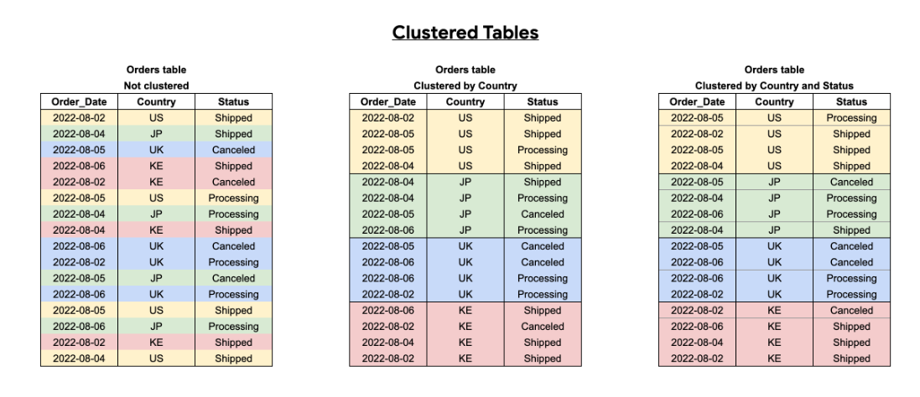
Clustered Tables
Overview
Table data is automatically organized based on the contents of one or more columns
When you cluster a table using multiple columns, the order of columns you specify is important
The order of the specified columns determines the sort order of the data
Clustering can improve the performance of queries and reduce the query cost

Slide 46
Clustered Tables
When to use?
You don't need strict cost guarantees before running the query.
You need more granularity than partitioning alone allows. To get clustering benefits in addition to partitioning benefits, you can use the same column for both partitioning and clustering.
Your queries commonly use filters or aggregation against multiple particular columns.
Prefer clustering over partitioning under the following circumstances:
Partitioning results in a small amount of data per partition (approximately less than 1 GB)
Partitioning results in a large number of partitions beyond the limits on partitioned tables
Partitioning results in your mutation operations modifying the majority of partitions in the table frequently (for example, every few minutes)

Slide 47
When to use Clustering
More granularity is required than partitioning allows.
You frequently use filters or aggregation against several columns in your queries.
When a column or group of columns has a high cardinality of values.
Strict cost estimations are not required prior to query execution.

Slide 48
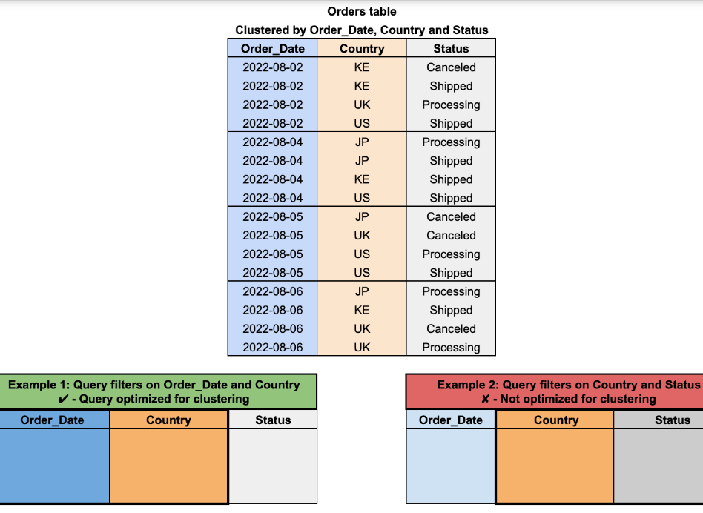
Features of Clustered Tables
Block Pruning
Automatic Reclustering
Cluster Column Ordering

Slide 49
Limitations
For both querying and writing query results to clustered tables, only GoogleSQL is supported.
There are just four clustering columns that you can select. If you require more columns, you might want to think about combining partitioning and clustering.
BigQuery clusters the data using only the first 1,024 characters when using STRING type columns.
The data is not automatically clustered when you convert a non-clustered table to a clustered one.

Slide 50
Quotas and Pricing
BigQuery restricts the quotas and limits on the use of shared Google Cloud resources
You are restricted by partitioned table limits when you use the clustered table functionality with a partitioned table.
The amount of data you store in the tables and the queries you perform against it determine how much it costs to create and use clustered tables in BigQuery.

Slide 51
Create Clustered Tables
Create a table from a query result
Run a DDL CREATE TABLE AS SELECT statement.
Run a query that creates a clustered destination table.
Use a DDL CREATE TABLE statement with a CLUSTER BY clause containing
a clustering_column_list.
Run the bq command-line tool bq mk command.
Make calls to the tables.insert API method.
Load data into BigQuery.
Use the client libraries.

Slide 52
Manage Clustered Tables
We can list and view the Clustered Tables using below ways:
Using the Google Cloud console
Using the bq command-line tool's bq query /bq ls command
Calling the tables.list API method to view the clustered tables
Calling the jobs.insert method and configuring a query job
Using the client libraries

Slide 53
Querying Best Practices
Filter clustered columns by sort order
Do not use clustered columns in complex filter expressions
Do not compare clustered columns to other columns
Notes:
Filter clustered columns by sort order
Do not use clustered columns in complex filter expressions
Do not compare clustered columns to other columns

Slide 54
Sharded Tables
The sharding approach splits the data into multiple tables and provides each table with a naming prefix, such as MYTABLE_YYYYMMDD.
This prevents data from being duplicated because each day in a query is in essence a unique table.
Extracting historical data (via an ETL) is one of the most frequent scenarios where sharding is used

Slide 55
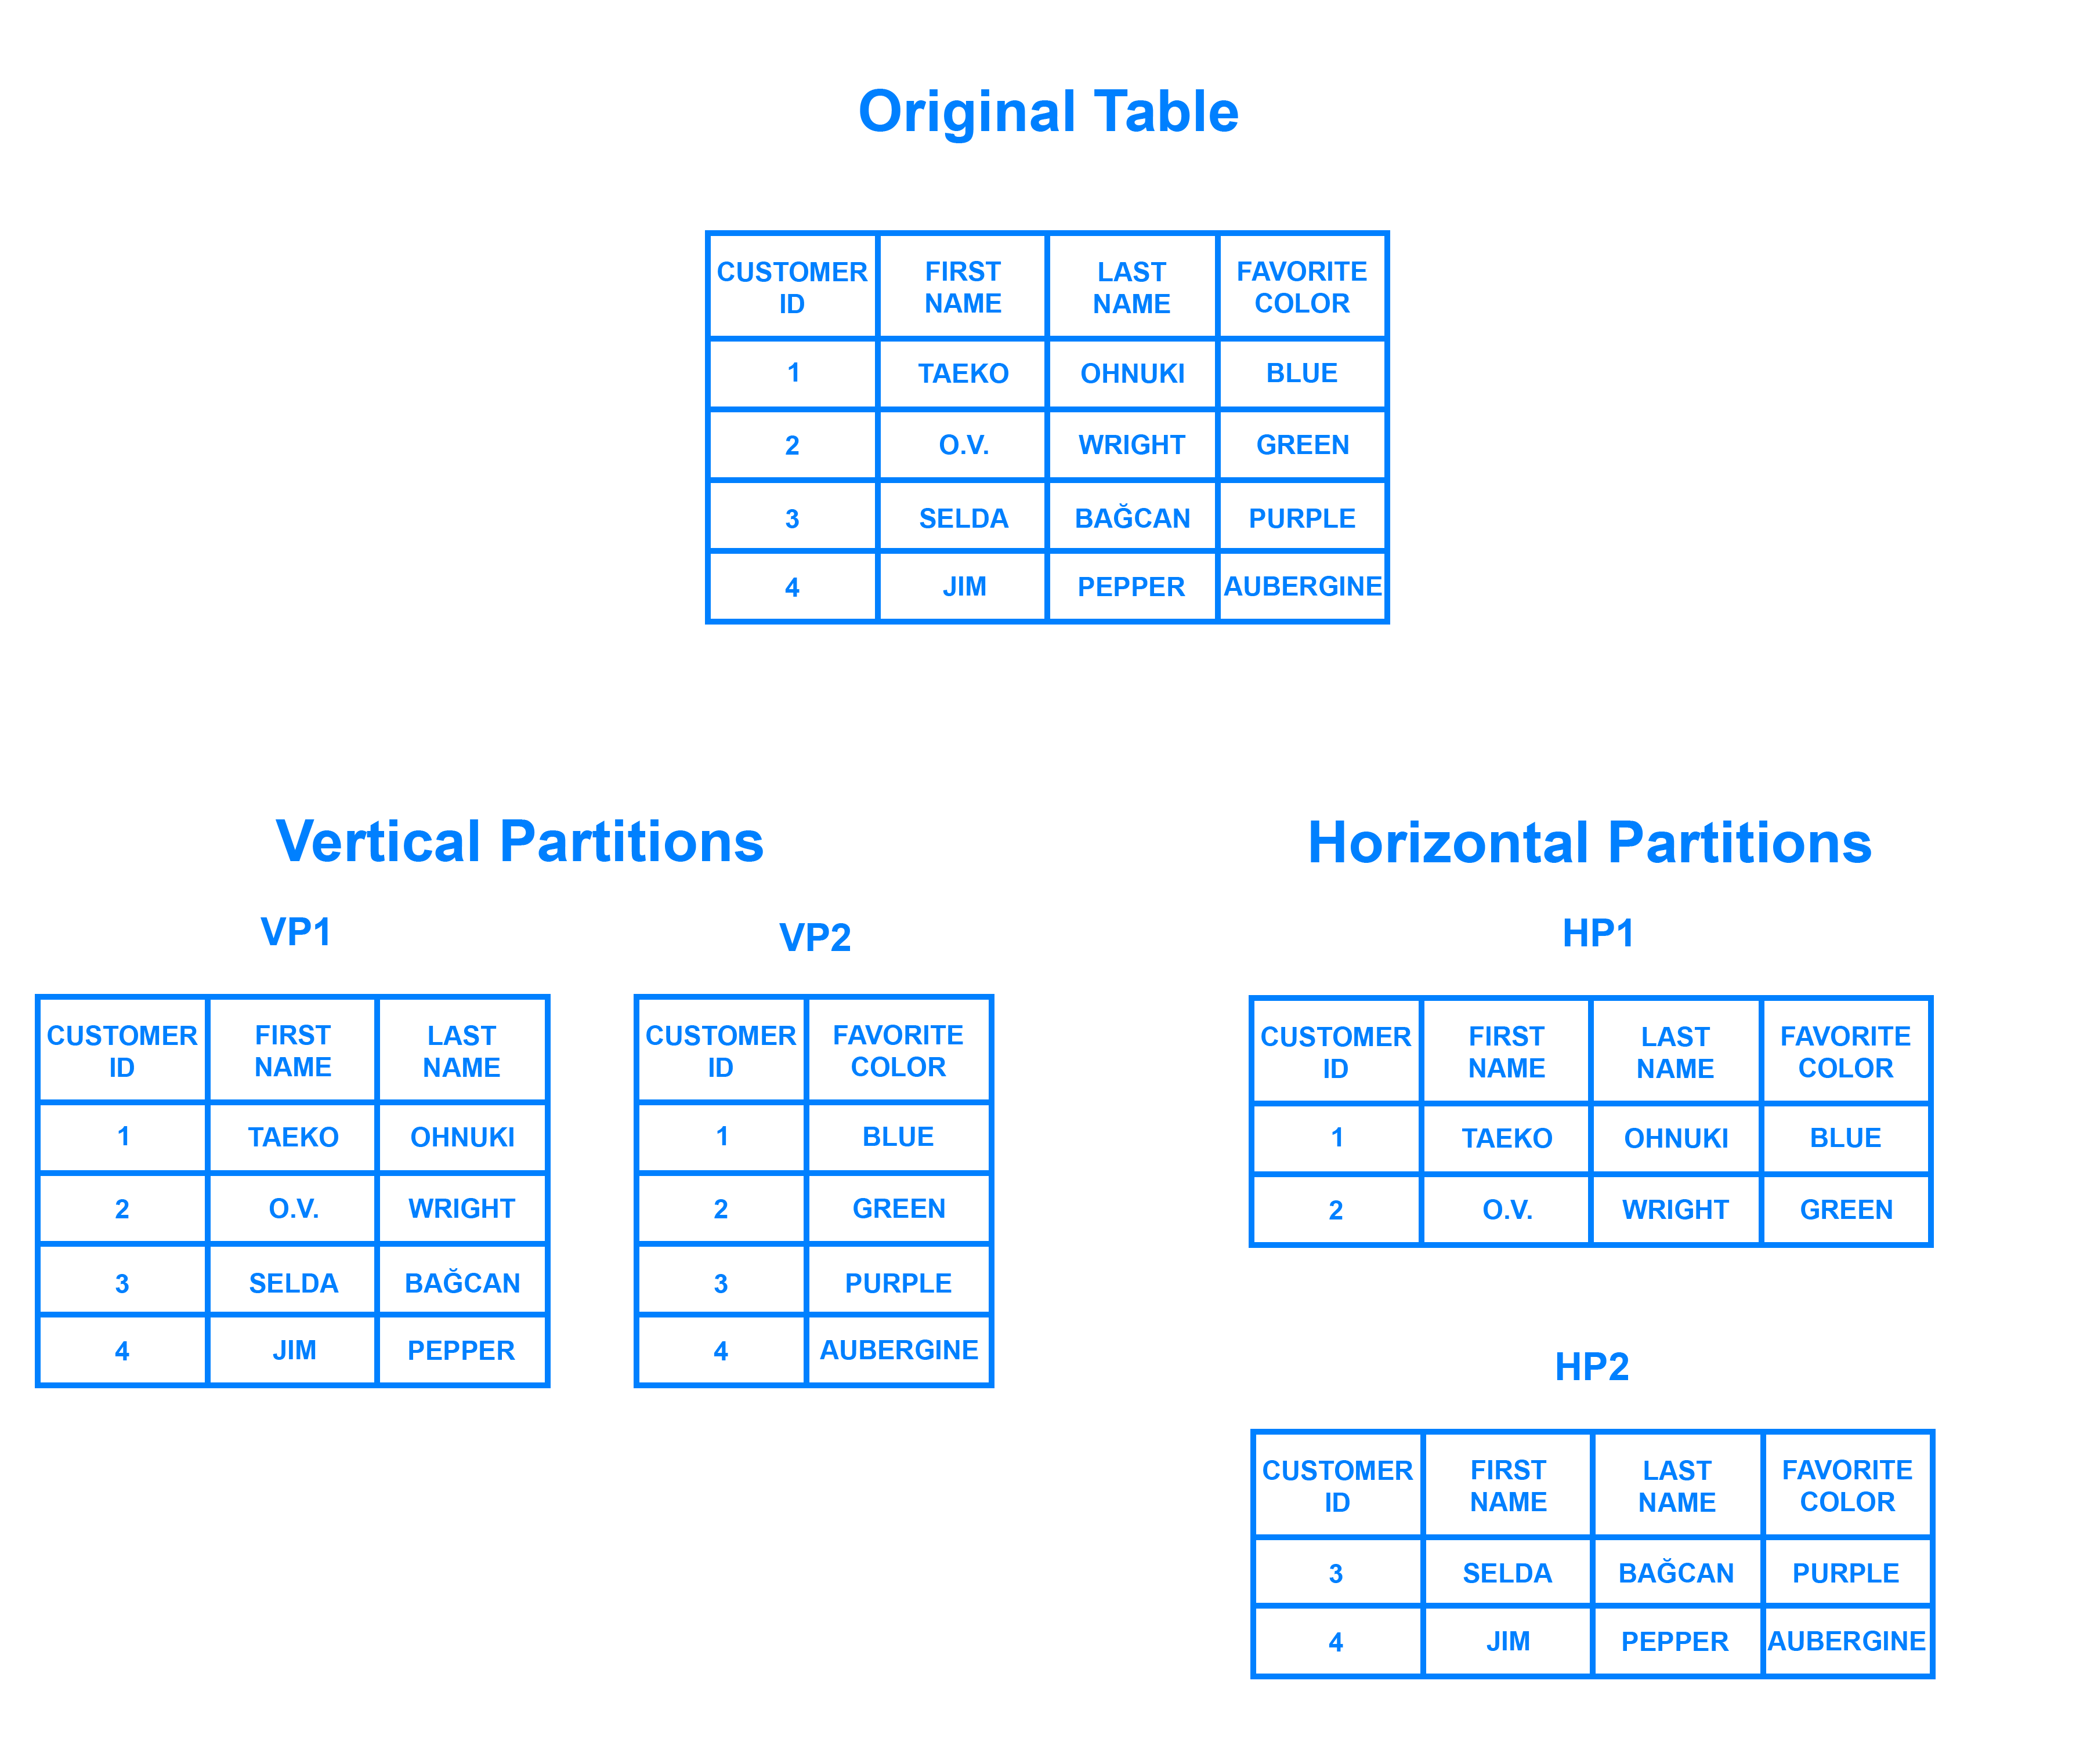
Sharded Tables
Sharding is a database architecture pattern related to horizontal partitioning .
It means the practice of separating one table’s rows into multiple different tables, known as partitions.
Each partition has the same schema and columns, but also entirely different rows.

Slide 56
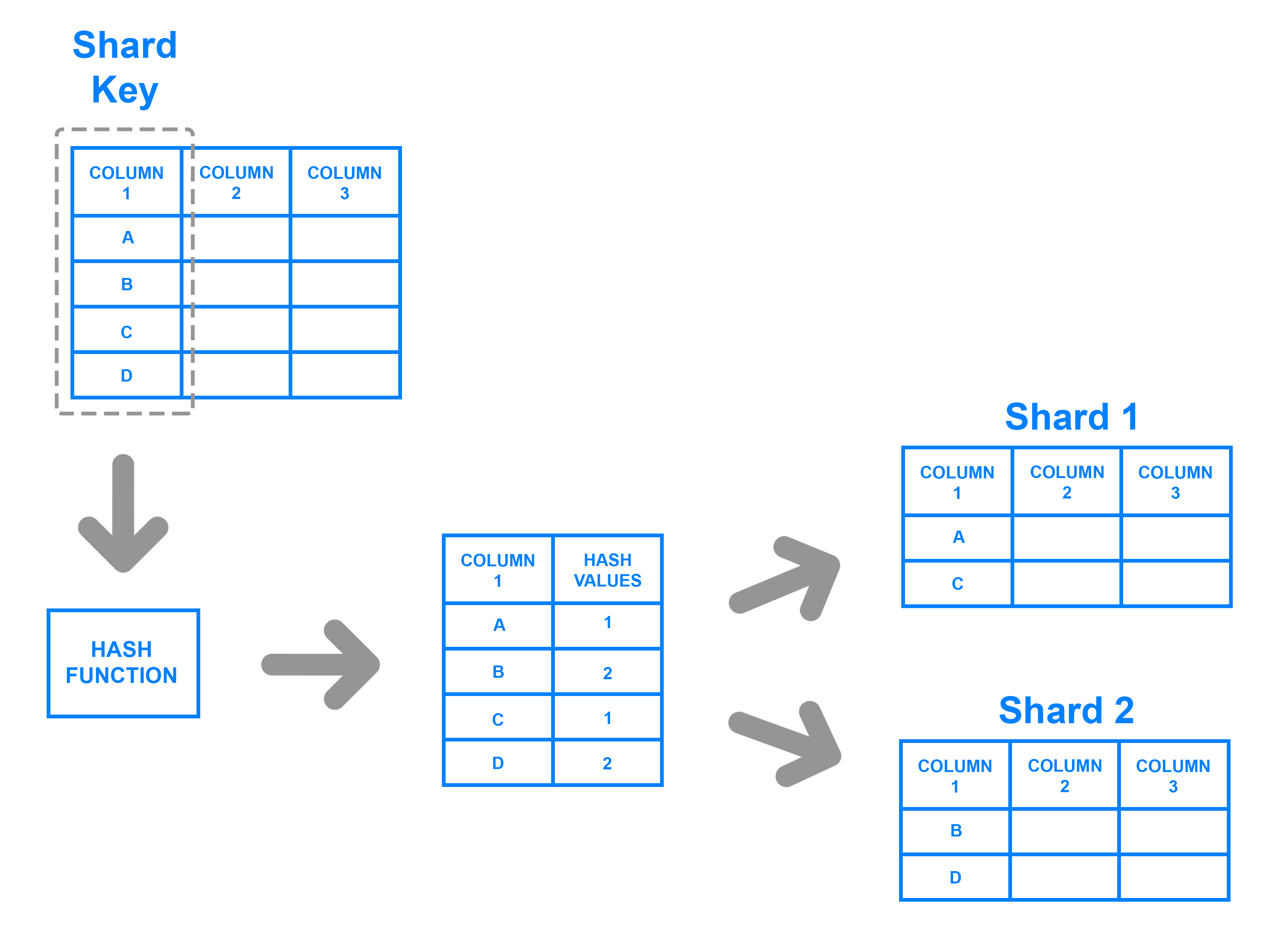
Architecture
Key Based Sharding
Notes:
Key Based Sharding
Range Based Sharding
Directory Based Sharding

Slide 57
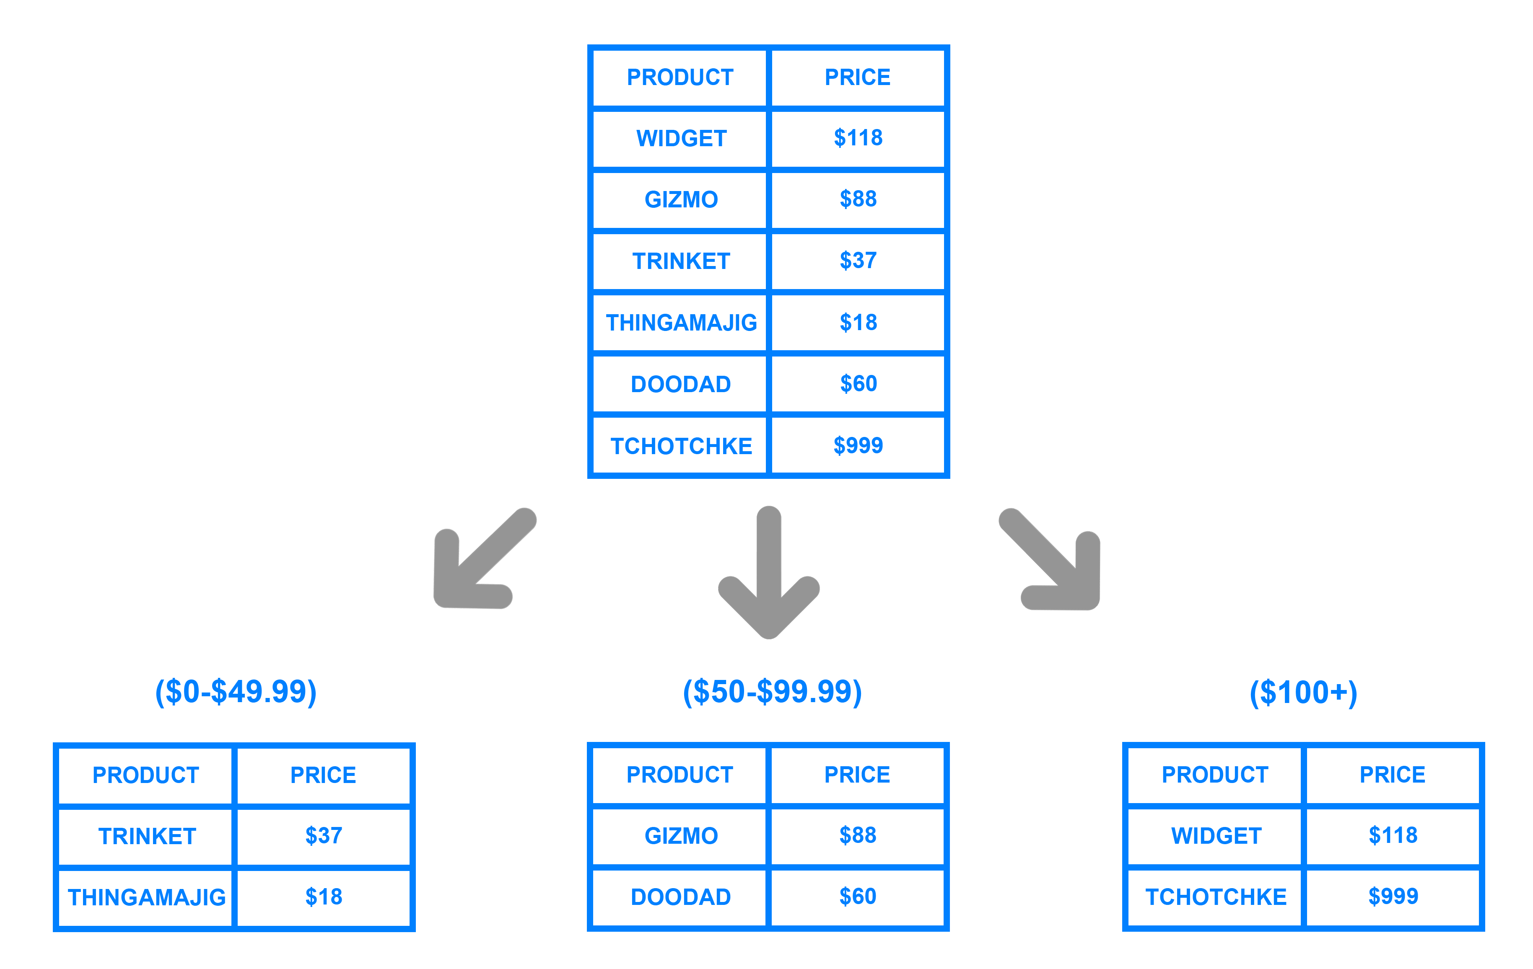
Architecture
Range Based Sharding
Notes:
Key Based Sharding
Range Based Sharding
Directory Based Sharding

Slide 58
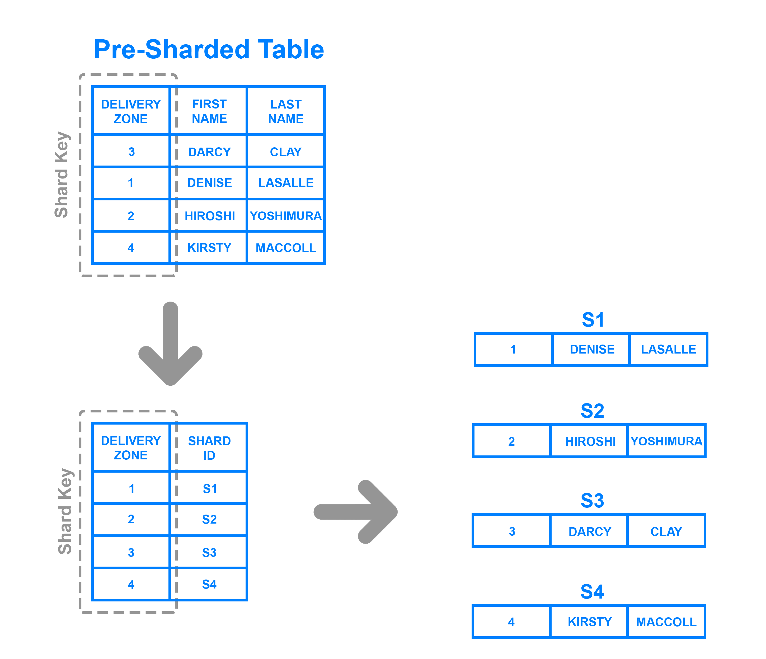
Architecture
Directory Based Sharding
Notes:
Key Based Sharding
Range Based Sharding
Directory Based Sharding

Slide 59
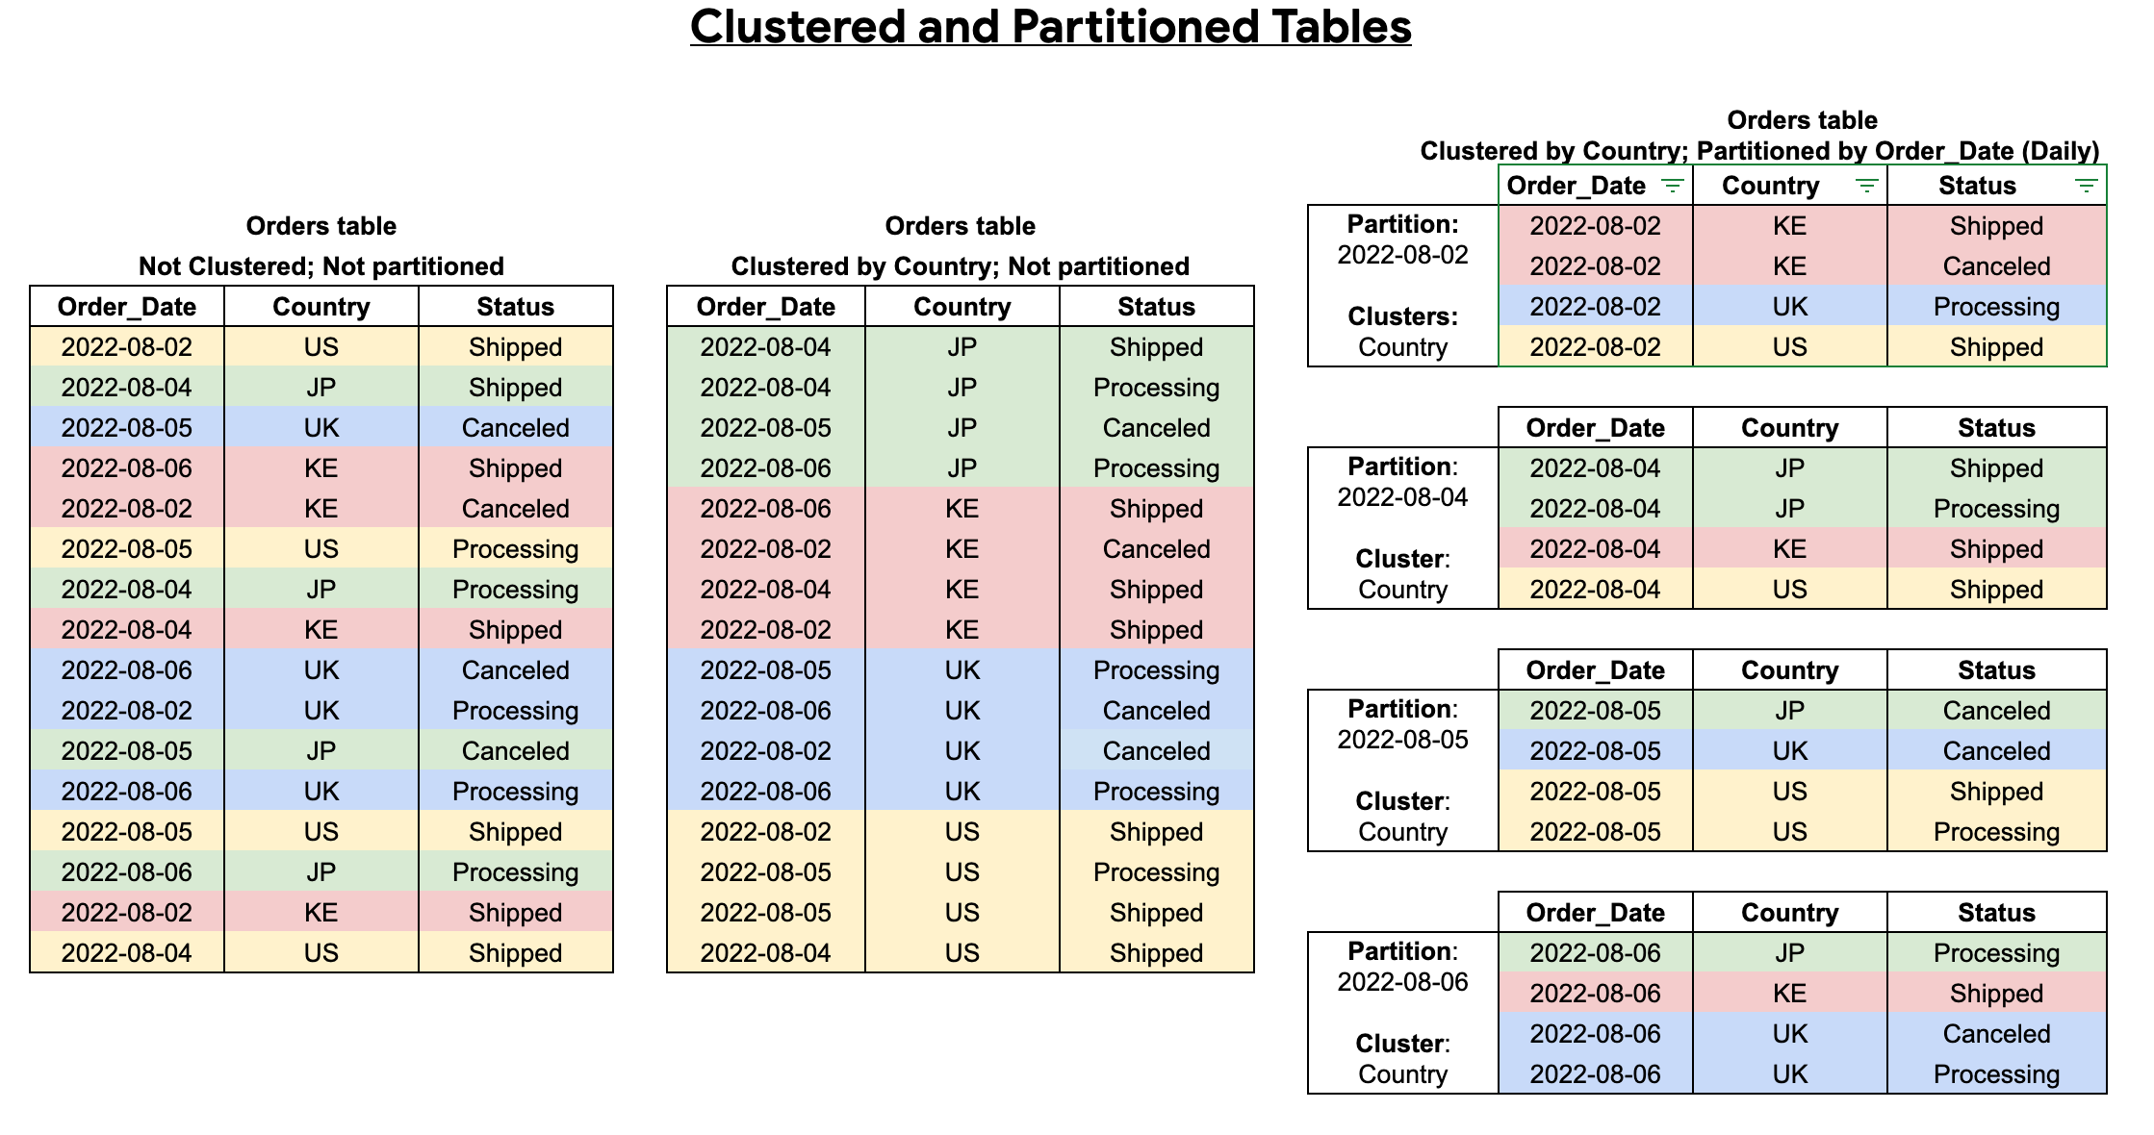
Clustered and Partitioned tables
Notes:
clustered and partitioned tables

Slide 60
Partitioning Vs Sharding
Partitioning
Sharding
Data split into logical horizontal groups
Managed by BigQuery
Metadata and access control automatically applied
More efficient
Less flexible
Data split into logical horizontal groups
Manually performed by user
Metadata and access control must be individually applied to shards
Less efficient
More flexible

Slide 61
BigQuery Views

Slide 62
BigQuery Views
Virtual table defined by a SQL query
Whenever a user queries the view, the underlying view-query is executed
Reduce query complexity
Restrict access to data
Construct different logical tables from the same physical table
Notes:
GFS: Google file system
Capacitor and Colossus are key ingredients of industry-leading performance characteristics offered by BigQuery

Slide 63
Creating Views
You can create a view in BigQuery in the following ways
Using the Google Cloud console.
Using the bq command-line tool's bq mk command.
Calling the tables.insert API method.
Using the client libraries.
Submitting a CREATE VIEW data definition language (DDL) statement.

Slide 64
Managing views
You can manage your BigQuery views in the following ways
Update a view
Copy a view
Rename a view
Delete a view

Slide 65
Advantages of Views
Views provides an extra layer of security.
It simplifies the complexity of large data.
It ensures data consistency
It maintains data integrity
Notes:
Security
Each user can be given permission to access the database only through a small set of views that contain the specific data the user is authorized to see, thus restricting the user's access to stored data
Query Simplicity
A view can draw data from several different tables and present it as a single table, turning multi-table queries into single-table queries against the view.
Structural simplicity
Views can give a user a "personalized" view of the database structure, presenting the database as a set of virtual tables that make sense for that user.
Consistency
A view can present a consistent, unchanged image of the structure of the database, even if the underlying source tables are split, restructured, or renamed.
Data Integrity
If data is accessed and entered through a view, the DBMS can automatically check the data to ensure that it meets the specified integrity constraints.

Slide 66
View limitations
BigQuery views are subject to the following limitations:
Views are read-only.
A reference inside of a view must be qualified with a dataset.
You cannot mix GoogleSQL and legacy SQL queries when using views.
You cannot reference query parameters in views.
You cannot include a temporary user-defined function or a temporary table in the SQL query that defines a view

Slide 67
Materialized views
Introduction
Beta service
Materialized views are precomputed views that periodically cache results of a query for increased performance and efficiency
BigQuery leverages precomputed results from materialized views and whenever possible reads only delta changes from the base table to compute up-to-date results
Materialized views can be queried directly or can be used by the BigQuery optimizer to process queries to the base tables
Queries that use materialized views are generally faster and consume less resources than queries that retrieve the same data only from the base table

Slide 68
Materialized views
[ WITH cte [, …]] SELECT [{ ALL | DISTINCT }] expression [ [ AS ] alias ] [, ...] FROM from_item [, ...] [ WHERE bool_expression ] [ GROUP BY expression [, ...] ] from_item: { table_name [ as_alias ] | { join_operation | ( join_operation ) } | field_path | unnest_operator | cte_name [ as_alias ] } as_alias: [ AS ] alias
Notes:
Materialized views use a restricted SQL syntax. Queries must use the following pattern:

Slide 69
Limitations
Aggregate requirements
CREATE MATERIALIZED VIEW dataset.mv AS ( SELECT s_store_sk, s_country, s_zip, SUM(ss_net_paid) AS sum_sales, FROM dataset.store_sales LEFT JOIN dataset.store ON ss_store_sk = s_store_sk GROUP BY 1, 2, 3 );
CREATE MATERIALIZED VIEW dataset.mv PARTITION BY DATE(ts_hour) AS ( SELECT SELECT TIMESTAMP_TRUNC(ts, HOUR) AS ts_hour, SUM(sales) sum_sales FROM (SELECT ts, sales from dataset.table1 UNION ALL SELECT ts, sales from dataset.table2) GROUP BY 1 );
Notes:
CREATE MATERIALIZED VIEW dataset.mv PARTITION BY DATE(ts_hour) AS ( SELECT SELECT TIMESTAMP_TRUNC(ts, HOUR) AS ts_hour, SUM(sales) sum_sales FROM (SELECT ts, sales from dataset.table1 UNION ALL SELECT ts, sales from dataset.table2) GROUP BY 1 );

Slide 70
Limitations
WITH CLAUSE
WITH tmp AS ( SELECT TIMESTAMP_TRUNC(ts, HOUR) AS ts_hour, * FROM mydataset.mytable ) SELECT ts_hour, COUNT(*) AS cnt FROM tmp GROUP BY ts_hour;
WITH tmp AS ( SELECT city, COUNT(*) AS population FROM mydataset.mytable GROUP BY city ) SELECT population, COUNT(*) AS cnt GROUP BY population;
Notes:
WITH tmp AS ( SELECT city, COUNT(*) AS population FROM mydataset.mytable GROUP BY city ) SELECT population, COUNT(*) AS cnt GROUP BY population;

Slide 71
Partioned Materialized Views
WITH CLAUSE
WITH tmp AS ( SELECT TIMESTAMP_TRUNC(ts, HOUR) AS ts_hour, * FROM mydataset.mytable ) SELECT ts_hour, COUNT(*) AS cnt FROM tmp GROUP BY ts_hour;
WITH tmp AS ( SELECT city, COUNT(*) AS population FROM mydataset.mytable GROUP BY city ) SELECT population, COUNT(*) AS cnt GROUP BY population;
Notes:
WITH tmp AS ( SELECT city, COUNT(*) AS population FROM mydataset.mytable GROUP BY city ) SELECT population, COUNT(*) AS cnt GROUP BY population;

Slide 72
Materialized views
Costing
Costs are associated with BigQuery Materialized Views for the following components:
Querying materialized views
Maintaining materialized views, such as when the view is refreshed
Storing materialized view tables

Slide 73
Managing Materialized views
BigQuery management of materialized views includes the following operations:
Alter materialized views
List materialized views
Delete materialized views
Refresh materialized views

Slide 74
String Functions
These string functions work on STRING and BYTES data types.
STRING values must be well-formed UTF-8.
Functions that return position values, such as STRPOS, encode those positions as INT64.
The value 1 refers to the first character (or byte), 2 refers to the second, and so on.
The value 0 indicates an invalid position. When working on STRING types, the returned positions refer to character positions.

Slide 75
Querying DataSet

Slide 76
String Functions
Some of the String Functions are
LENGTH
CONCAT
REPEAT
REPLACE
REVERSE
LTRIM & RTRIM
SPLIT
SUBSTR
UPPER & LOWER
STRPOS

Slide 77
Date Functions
Name | Summary
CURRENT_DATE | Returns the current date as a DATE value.
DATE | Constructs a DATE value.
DATE_ADD | Adds a specified time interval to a DATE value.
DATE_DIFF | Gets the number of intervals between two DATE values.
DATE_FROM_UNIX_DATE | Interprets an INT64 expression as the number of days since 1970-01-01.
DATE_SUB | Subtracts a specified time interval from a DATE value.
DATE_TRUNC | Truncates a DATE value.
EXTRACT | Extracts part of a date from a DATE value.
FORMAT_DATE | Formats a DATE value according to a specified format string.
LAST_DAY | Gets the last day in a specified time period that contains a DATE value.
PARSE_DATE | Converts a STRING value to a DATE value.
UNIX_DATE | Converts a DATE value to the number of days since 1970-01-01.
GoogleSQL for BigQuery supports the following date functions.

Slide 78
DateTime Functions
Name | Summary
CURRENT_DATETIME | Returns the current date and time as a DATETIME value.
DATETIME | Constructs a DATETIME value.
DATETIME_ADD | Adds a specified time interval to a DATETIME value.
DATETIME_DIFF | Gets the number of intervals between two DATETIME values.
DATETIME_SUB | Subtracts a specified time interval from a DATETIME value.
DATETIME_TRUNC | Truncates a DATETIME value.
EXTRACT | Extracts part of a date and time from a DATETIME value.
FORMAT_DATETIME | Formats a DATETIME value according to a specified format string.
LAST_DAY | Gets the last day in a specified time period that contains a DATETIME value.
PARSE_DATETIME | Converts a STRING value to a DATETIME value.
GoogleSQL for BigQuery supports the following datetime functions.

Slide 79
Introduction to Routines
In BigQuery, routines are a resource type that includes the following:
Stored procedures
User-defined functions (UDFs)

Slide 80
User-defined functions
A user-defined function (UDF) lets you create a function by using a SQL expression or JavaScript code. A UDF accepts columns of input, performs actions on the input, and returns the result of those actions as a value.
Temporary Functions
CREATE TEMP FUNCTION addFourAndDivideAny(x ANY TYPE, y ANY TYPE) AS ( (x + 4) / y ); SELECT addFourAndDivideAny(3, 4) AS integer_input, addFourAndDivideAny(1.59, 3.14) AS floating_point_input;
Persistent Functions
CREATE FUNCTION mydataset.AddFourAndDivide(x INT64, y INT64) RETURNS FLOAT64 AS ( (x + 4) / y );

Slide 81
Stored Procedure
A stored procedure is a collection of statements that can be called from other queries or other stored procedures. A procedure can take input arguments and return values as output.
Stored Procedure
CREATE PROCEDURE dataset_name.procedure_name(Arguments) BEGIN -- statements here END
Calling for Store Procedure CALL dataset_name.procedure_name()

Slide 82
Advanced Analysis

Slide 83
Window Functions
A window function, also known as an analytic function, computes values over a group of rows and returns a single result for each row. This is different from an aggregate function, which returns a single result for a group of rows.
A window function includes an OVER clause, which defines a window of rows around the row being evaluated. For each row, the window function result is computed using the selected window of rows as input, possibly doing aggregation.
With window functions you can compute moving averages, rank items, calculate cumulative sums, and perform other analyses.

Slide 84
Window Functions
Syntax
function_name ( [ argument_list ] ) OVER over_clause
over_clause:
{ named_window | ( [ window_specification ] ) }
window_specification:
[ named_window ]
[ PARTITION BY partition_expression [, ...] ]
[ ORDER BY expression [ { ASC | DESC } ] [, ...] ]
[ window_frame_clause ]
window_frame_clause:
{ rows_range } { frame_start | frame_between }
rows_range:
{ ROWS | RANGE }

Slide 85
Window Functions
We can define the window functions as below
Defining the OVER clause
Defining the window specification
Defining the window frame clause
Notes:
https://cloud.google.com/bigquery/docs/reference/standard-sql/window-function-calls

Slide 86
Geospatial Data
Geospatial analytics let you analyze geographic data in BigQuery. Geographic data is also known as geospatial data
Common types of objects when working with geospatial data include the following:
A geometry represents a surface area on the Earth.
A spatial feature represents a logical spatial object. It combines a geometry with additional attributes that are application-specific.
A spatial feature collection is a set of spatial features.
Notes:
https://cloud.google.com/bigquery/docs/geospatial-data

Slide 87
Working with geospatial data
Transforming geospatial data
Partitioning and clustering geospatial data
Using JOINs with spatial data
Exporting spatial data
Notes:
https://cloud.google.com/bigquery/docs/geospatial-data

Slide 88
Loading geospatial data
Single points on Earth can be described by just a longitude, latitude pair.
For more complex geographies, you can load the following geospatial data formats into a GEOGRAPHY column:
Well-known text (WKT)
Well-known binary (WKB)
GeoJSON
Notes:
https://cloud.google.com/bigquery/docs/geospatial-data

Slide 89
Visualize geospatial data
Geospatial analytics lets you visualize geographic location data by using:
Looker Studio
BigQuery Geo Viz
Google Earth Engine
Jupyter notebooks
Notes:
https://cloud.google.com/bigquery/docs/geospatial-visualize

Slide 90
Visualize geospatial data
Geospatial analytics lets you visualize geographic location data by using:
Looker Studio
BigQuery Geo Viz
Google Earth Engine
Jupyter notebooks
Notes:
https://cloud.google.com/bigquery/docs/geospatial-visualize

Slide 91
Geospatial Analytics
Geospatial analytics lets you analyze and visualize geospatial data in BigQuery.
We can use Geospatial Analytics to perform below things:
Use a geospatial analytics function to convert latitude and longitude columns into geographical points
Run a query that finds all the Citi Bike stations with more than 30 bikes available for rental
Visualize your results in BigQuery Geo Viz
Notes:
https://cloud.google.com/bigquery/docs/geospatial-visualize

Slide 92
BigQuery Omni & Best Practices

Slide 93
Introduction to BigQuery Omni
With BigQuery Omni, you can run BigQuery analytics on data stored in Amazon Simple Storage Service (Amazon S3) or Azure Blob Storage using BigLake tables.
To run BigQuery analytics on your external data, you first need to connect to Amazon S3 or Blob Storage.
BigQuery Omni offers a cross-cloud analytics solution with the ability to analyze data where it is and the flexibility to replicate data when necessary
Notes:
https://cloud.google.com/bigquery/docs/omni-introduction

Slide 94
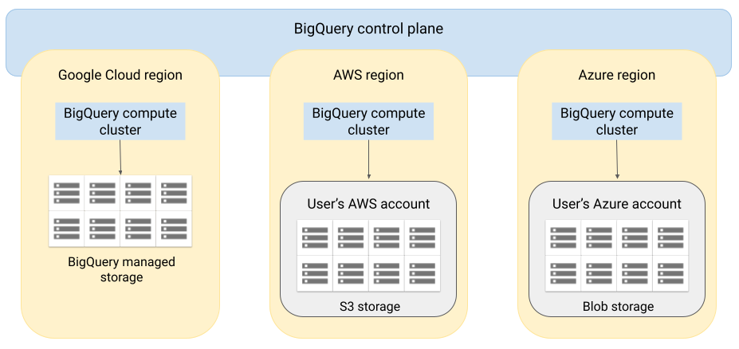
Architecture
Notes:
https://cloud.google.com/bigquery/docs/omni-introduction

Slide 95
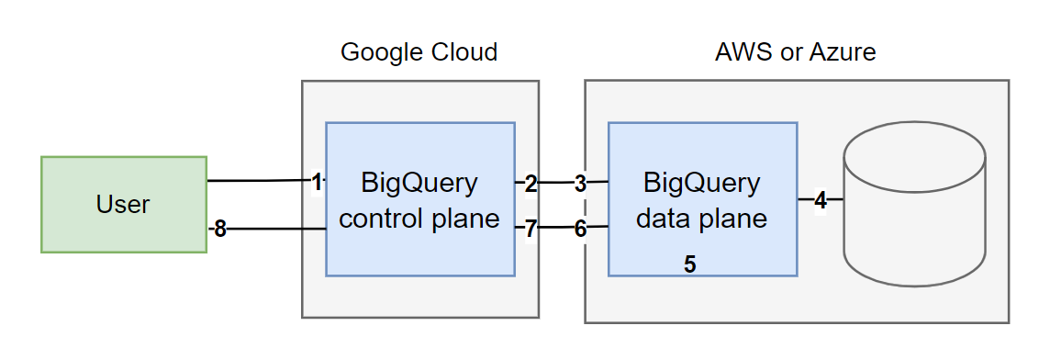
Data flow when querying data
The following image describes how the data moves between Google Cloud and AWS or Azure for the following queries:
SELECT statement
CREATE EXTERNAL TABLE statement
Notes:
https://cloud.google.com/bigquery/docs/omni-introduction

Slide 96
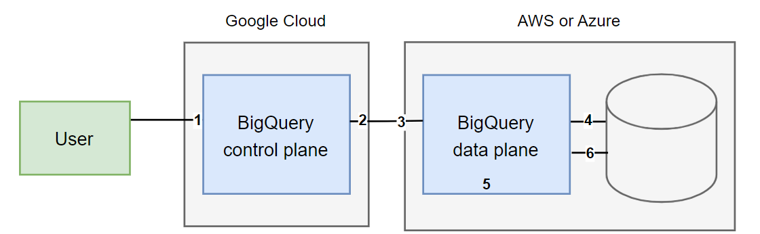
Data flow when exporting data
You can see in the below diagram how data moves between Google Cloud and AWS or Azure during an EXPORT DATA statement.
Notes:
https://cloud.google.com/bigquery/docs/omni-introduction

Slide 97
Benefits
Performance
Cost
Security and data governance
Serverless architecture
Ease of management
Cross-cloud transfer
Notes:
https://cloud.google.com/bigquery/docs/geospatial-data’
Demo with AWS or AZURE to be shown

Slide 98
Best Practices
You can reduce data that needs to be processed by using the options described in the following sections.
Avoid SELECT *
Avoid excessive wildcard tables
Avoid tables sharded by date
Avoid oversharding tables
Prune partitioned queries
Reduce data before using a JOIN
Notes:
https://cloud.google.com/bigquery/docs/best-practices-performance-compute

Slide 99
Best Practices
You can optimize your query operations by using the options described in the following sections.
Avoid repeatedly transforming data
Avoid multiple evaluations of the same CTEs
Avoid repeated joins and subqueries
Optimize your join patterns
Optimize the ORDER BY clause
Split complex queries into smaller ones
Use nested and repeated fields
Notes:
https://cloud.google.com/bigquery/docs/best-practices-performance-compute

Slide 100
Best Practices
You can reduce the query outputs by using the options described in the following the sections.
Materialize large result sets
The following best practices provide guidance on avoiding query anti-patterns that impact performance in BigQuery.
Avoid self joins
Avoid cross joins
Avoid DML statements that update or insert single rows
Filter data for skewed data
Use alias names for similarly named columns
Specify primary key and foreign key constraints
Notes:
https://cloud.google.com/bigquery/docs/best-practices-performance-compute

Slide 101
Notebooks

Slide 102
Introduction to Notebook
Notebooks can be used to complete analysis and machine learning (ML) workflows by using SQL, Python, and other common packages and APIs.
Notebooks offer improved collaboration and management with the following options:
Share notebooks with specific users and groups by using Identity and Access Management (IAM).
Review the notebook version history.
Revert to or branch from previous versions of the notebook.

Slide 103
Benefits
DataFrames can be integrated into notebooks.
Assistive code development.
Visualize data using popular libraries
Auto-completion of SQL statements.
Notes:
BigQuery DataFrames is integrated into notebooks, no setup required. BigQuery DataFrames is a Python API that you can use to analyze BigQuery data at scale by using the pandas DataFrame and scikit-learn APIs.
Assistive code development powered by Gemini generative AI.
Auto-completion of SQL statements, the same as in the BigQuery editor.
The ability to save, share, and manage versions of notebooks.
The ability to use matplotlib, seaborn, and other popular libraries to visualize data at any point in your workflow.

Slide 104
Introduction to BigQuery DataFrames
BigQuery DataFrames is a set of open source Python libraries.
BigQuery DataFrames implements the pandas and scikit-learn APIS by pushing the processing down to BigQuery through SQL conversion
BigQuery DataFrames uses BigQuery, Cloud Functions, Vertex AI, and other Google Cloud services, which incur their own costs.
BigQuery DataFrames is distributed with the Apache-2.0 license

Slide 105
Using BigQuery DataFrames
BigQuery DataFrames provides a Pythonic DataFrame and machine learning (ML) API powered by the BigQuery engine.
BigQuery DataFrames is an open-source package. You can run to install the latest version
The bigframes.pandas library provides pandas -like API that you can use to analyze and manipulate data in BigQuery.
BigQuery DataFrames provides two libraries bigframes.pandas & bigframes.ml
The bigframes.ml supports the same locations as BigQuery ML. BigQuery ML model prediction and other ML functions are supported in all BigQuery regions
Notes:
bigframes.pandas, which provides a pandas-compatible API for analytics.
bigframes.ml, which provides a scikit-learn-like API for machine learning (ML).
https://cloud.google.com/bigquery/docs/use-bigquery-dataframes

Slide 106
Managing Runtime & Security
BigQuery uses Vertex AI runtimes to run notebooks.
You control access to notebooks by using Identity and Access Management (IAM) roles
Notes:
A notebook runtime is a Compute Engine virtual machine allocated to a particular user to enable code execution in a notebook.
Multiple notebooks can share the same runtime. However, each runtime belongs to only one user and can't be used by others

Slide 107
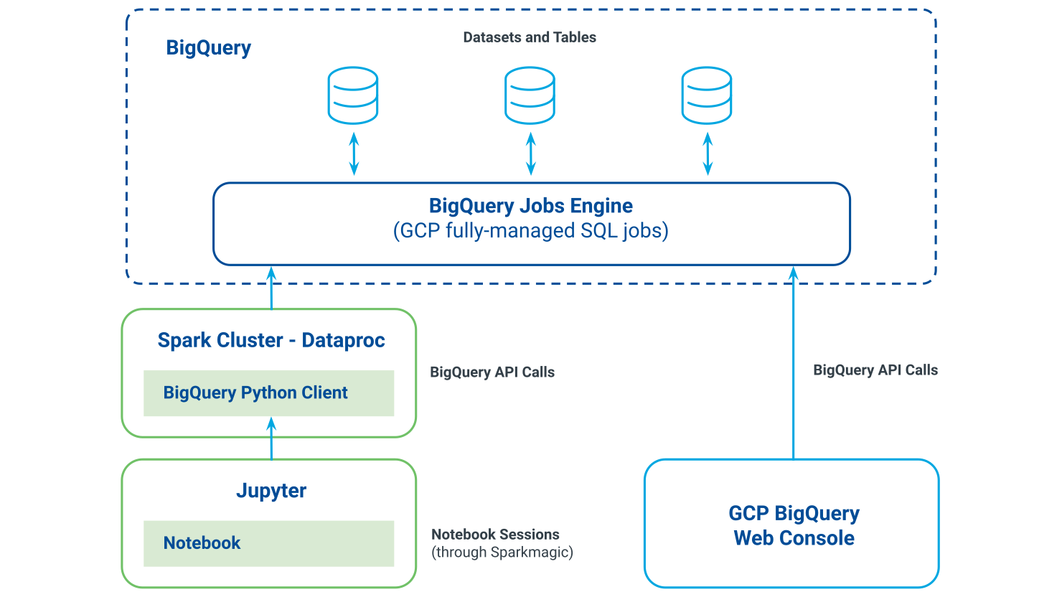
Working with Jupyter and BigQuery Python Client
Notes:
https://docs.liveramp.com/safe-haven/en/working-with-jupyter-and-bigquery-python-client.html

Slide 108
Creating Notebook

Slide 109
Creating Notebooks
To create Notebooks as a first step we need to make sure that BigQuery Studio is enabled
All users with the Dataform Admin (roles/dataform.admin) role have owner access to all notebooks created in the project.
IAM Roles to create Notebooks
BigQuery Read Session User (roles/bigquery.readSessionUser)
BigQuery Studio User (roles/bigquery.studioUser)
The BigQuery Studio User role combines the following IAM roles:
BigQuery Job User (roles/bigquery.jobUser)
Notebook Runtime User (roles/aiplatform.notebookRuntimeUser)
Code Creator (roles/dataform.codeCreator)

Slide 110
Editing Notebooks
Permissions to edit notebooks
To edit and run notebooks, you need the following IAM roles:
BigQuery Job User (roles/bigquery.jobUser)
BigQuery Read Session User (roles/bigquery.readSessionUser)
Notebook Runtime User (roles/aiplatform.notebookRuntimeUser)
Code Editor (roles/dataform.codeEditor)

Slide 111
Viewing Notebooks
Permissions to view notebooks
To view and run notebooks, you need the following IAM roles:
BigQuery Job User (roles/bigquery.jobUser)
BigQuery Read Session User (roles/bigquery.readSessionUser)
Notebook Runtime User (roles/aiplatform.notebookRuntimeUser)
Code Viewer (roles/dataform.codeViewer)

Slide 112
Explore Query Result
To explore the query result follow below steps
Open query results in a notebook
Prepare the notebook for use
Explore the data
Clean up

Slide 113
Understand the fundamentals of data warehousing and its role in modern analytics.
Learn the key features and capabilities of a serverless data warehouse.
Explore architecture, pricing models, and access roles for efficient data governance.
Understand how optimization techniques improve query performance and cost efficiency.
Learn how to create and use structured views for simplified and secure data access.
Develop SQL querying skills to retrieve and analyze large datasets efficiently.
Explore advanced analytics, including window functions, ML integration, and optimization.
Understand cross cloud analytics and best practices for security and performance.
Learn to use interactive notebooks for data exploration and analysis.

Slide 114
Thank You

